Slide 1
EPL646: Advanced Topics in Databases
AnyLog : A Grand Unification of the Internet of Things
Faisal Nawab (UC Santa Cruz)*; Daniel J Abadi (UMD); Owen Arden (UC Santa Cruz); Moshe Shadmon (AnyLog) 9th Biennial Conference on Innovative Data Systems Research (CIDR ‘19) January 13-16, 2019 , Asilomar, California, USA. http://cidrdb.org/cidr2020/papers/p9-abadi-cidr20.pdf
By : Erodotos Demetriou (edemet01@cs.ucy.ac.cy)
Instructor : Demetris Zeinalipour
https://www.cs.ucy.ac.cy/~dzeina/courses/epl646

Slide 2
Introduction
01
Architectural Overview
02
04
Normal-Case Operation
Decentralized Compensation
03
Agenda
05
Security Risks & Challenges
06
Use-Cases & Conclusion
What is AnyLog?
Components
System Model
Security Components
Data Publication
Storage & Query Processing
Compensation process by example Disputes
Query Integrity
Data Confidentiality
https://www.cs.ucy.ac.cy/~dzeina/courses/epl646

Slide 3
01
Introduction

Slide 4
The Problem
Introduction
Nowadays IoT devices have been populating in a great rate
We need a new different approach to manage IoT data in real time. Using traditional DB Systems and APIs to access and generate such a volume data is inefficient.
Another challenge for the IoT industry is that each device may generate data in a different schema. Also, some malicious devices may publish “fake” data.
“Modern Problems require Modern Solutions”
https://www.cs.ucy.ac.cy/~dzeina/courses/epl646

Slide 5

Introduction
What is AnyLog?
Is a Public/Permissionless Blockchain based Platform for IoT Data
Basic Idea
It allows to iot devices join a network where they can publish their data.
Then users will be able to access this information through a platform.
Publish Devices will get financial compensation for the data they provide to the network.
The whole System is built in such way that confidentiality and data availability are guaranteed.
Publishing
Sharing
Querying
AnyLog focuses on the idea of publishing data using our prefered schema and at the same time be able to specify the permissions of the data. (ie IoT data can be public and querable by anyone, or private and require a key to decrypt them). In addition, the reward mechanism avoids the advertisments model which we can find all over the WEB.
https://www.cs.ucy.ac.cy/~dzeina/courses/epl646

Slide 6
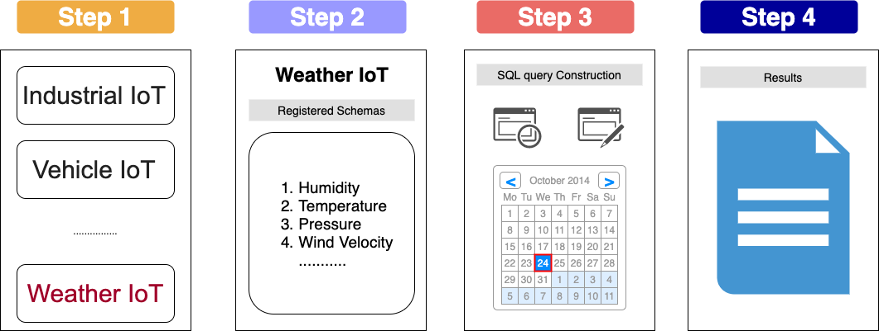
Introduction
Querying Data
It is very difficult to query the whole network using SQL (we have a lot of data schemas). Also, most of the users are not familiar with SQL or programming. For this reason AnyLog provides a friendly user interface to motivate users use this platform.
https://www.cs.ucy.ac.cy/~dzeina/courses/epl646

Slide 7
02
Architectural Overview

Slide 8
Architectural Overview
Components
Client | Produces SQL queries and consumes the results
Coordinator | This is a special server that receive SQL queries, and parse, optimize and coordinate their parallel execution across the network.
Contractor | Is a special sever on the network, that stores all data produced by the publishers. On this component queries are executed.
Publisher | Is any IoT device on the network which produce data and ship it to contractors for storage.
Blockchain | Is an infrastracture that maintains configurations and bookeeping information of the network global state. The blockchain is used to resolve any possible disputes among the participants.
https://www.cs.ucy.ac.cy/~dzeina/courses/epl646

Slide 9
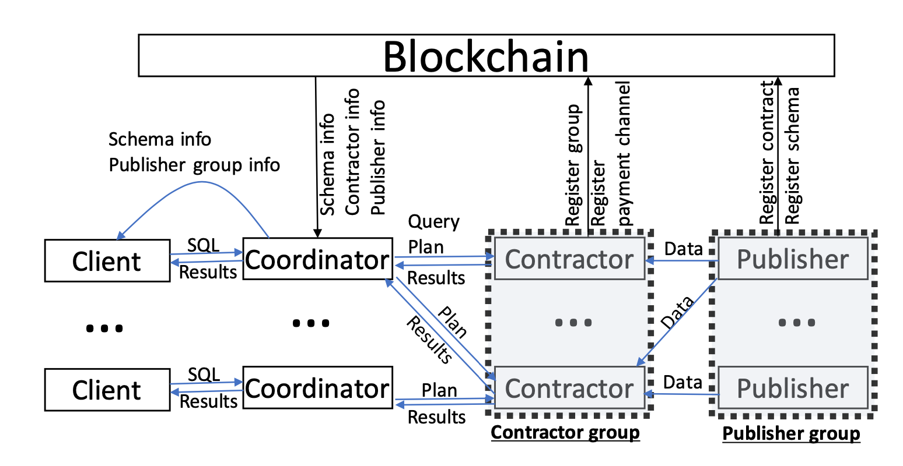
Architectural Overview
Execution Workflow
Contractors and Publishers usually form groups. Each group has a Group Manager
Publishers produce data in batches.
The execution plan is executed parallel on different Contractors.
Client pays the Coordinator for its operation.
Contractors receive a reward for their job from the Coordinators.
Whenever a query is accessing data, the publisher that generated the data is rewarded by the Contractor.
Blockchain is used only for metadata storage.
https://www.cs.ucy.ac.cy/~dzeina/courses/epl646

Slide 10
Architectural Overview
Security Components
Public Key Cryptography | All entities on the network are identified by a public key. Public/Private key cryptography is used to sign and authenticate messages between nodes
Query Result Integrity | To achieve query result integrity, Trusted Execution Environment is used. In other words we trust only certain hardware manufacturers.
Data Confidentiality | Publishers who do not trust the contractors for data storage, can post their data to them encrypted
Smart Contracts | Smart Contract is a kind of code that runs on the blockchain and can perform different check operations.
State Channels | Smart contracts invocation has some drawbacks. (latency, throughput, transaction fee). For this reason we create channels between nodes for direct node communication.
https://www.cs.ucy.ac.cy/~dzeina/courses/epl646

Slide 11
03
Decentralized Compensation

Slide 12
Decentralized Compensation
A brief Overview
On the AnyLog Network a node is compensated for each of the following activities
Data Publication | When a client or a Contractor access the data that a publisher has produced, the publisher is compensated.
Data Storage | A contractor is compensated by the publisher for storing its data. The compensation is defined on the smart contract. (usually this compensation is very small)
Data Processing / Contractor | A Contractor is compensated (by the client/coordinator) according to the computational power it uses to process the SQL query. This reward is defined in the smart contract between a publisher and the contractor.
Data Processing / Coordinator | A Coordinator receives compensation for the query optimization and processing.
https://www.cs.ucy.ac.cy/~dzeina/courses/epl646

Slide 13
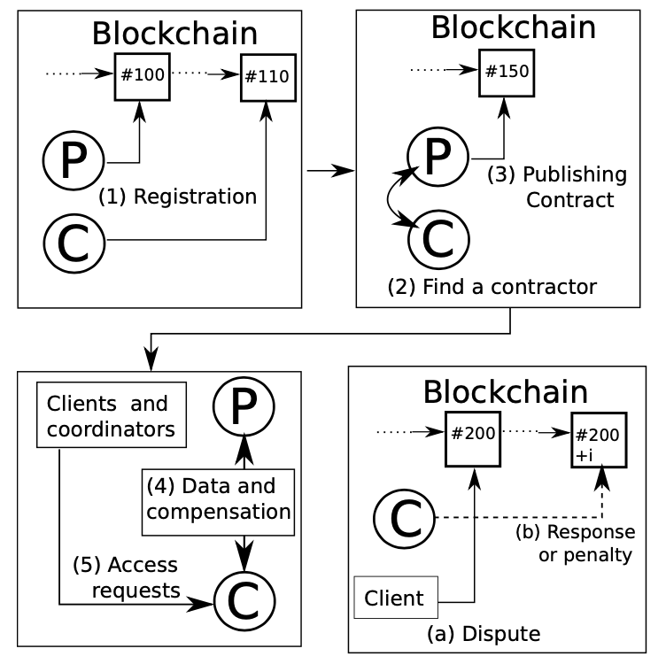
Decentralized Compensation
Compensation Rules On the Blockchain
Any rules that regard the compensation between different parties are defined on the smart contracts which run on the blockchain. To come to an agreement two nodes, first they have to discover each other. This is done by registering their presence on the Blockchain. Look a the picture below for details.
Publishers and Contractors register their selves on the Blockchain.
Each Publisher can register more than one schema on the BC.
Each Contractor can be registered more than one time, in order to advertise different properties.
When a Publisher finds a Contractor they agree on a contract which they publish on the Blockchain.
Clients/Coordinators can now find Coordinators and send to them data access requests.
Finally, there will be a compensation for Coordinators and Publishers. (compensation can be fulfilled on and off chain)
If the query response for any reason is not returned, we have a dispute which can be solved using the blockchain data.
https://www.cs.ucy.ac.cy/~dzeina/courses/epl646

Slide 14
Decentralized Compensation
Publishing Contracts
Further discussion on schema registration and contract publishment
Schema Registration
Global Unique Identifier
Schema Description
Schema backwards reference
DDL commands that define the schema
Additional set of rules
List of all publishers that use this schema
Schema publisher contact information
Contractor Registration
Contractor Group Global Unique Identifier
IP address and Port of at least one server in the group
Group member population
Information about publishers that the group has communication
Metadata (similar to the DBMS catalogue)
Contract document Registration
Publisher Group ID
Contractor Group ID
Contract Interval
Previous Contract ID
Revisions of the previous contract
Escrow payment from the Publisher to Contractor for data storage.
https://www.cs.ucy.ac.cy/~dzeina/courses/epl646

Slide 15
Decentralized Compensation
Compensation Processing
In AnyLog the payments (small amounts) between nodes occur frequently which is not very efficient on Blockchain. For this reason more practical solutions have been proposed.
State Channels – Off-Chain transaction
Two entities may exchange direct messages off-chain in order to add or subtract funds to their accounts. This is done using the escrow funds of each node.
Proof Of retrievability : A Publisher tests if a contractor is working properly and can forward the data it stores to the client. This is done with a simple Proof Of Retrievability request. If the Contractor fails to respond, then the Publisher may terminate their contract.
Fraud Detection on Blockchain
A Contractor has to pay a Publisher when it serves a query. This payment cannot be avoided since this transaction is written on the blockchain. In other words a Publisher knows when a query occurs and can calculate if the contractor has campansated him without any fraud.
https://www.cs.ucy.ac.cy/~dzeina/courses/epl646

Slide 16
Decentralized Compensation
Disputes
Many transactions in AnyLog are decentralized which may result to many problems caused by malicious/unresponsive nodes.
Unanswered Queries
Disputes over missing compensations
Disputes over incorrect results
These disputes are solved by enforcing Service License Agreements (SLA) over each node.
Usually disputes are solved with fine payment from escrow funds which are deposited
when a contract is formed between two nodes
https://www.cs.ucy.ac.cy/~dzeina/courses/epl646

Slide 17
04
Normal-Case Operation

Slide 18
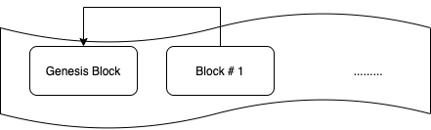
Normal-Case Operation
Accessing Metadata & Publishing Data
Accessing important metadata : All operations in AnyLog network require to access metadata during normal operation. As we discussed earlier some of this metadata in present on the Blockchain. We have to point out that the schema of this data has to be simple because it is frequently querable.
Client Query
Publisher Metadata
Node search Query
Contractor Metadata
Data Publication: As we discussed earlier every device can become a publisher. New publishers are motivated to join existing groups. All members of the same group must produce data according to the same schema version.
Publisher Manager : There is a Manager node per group which ensures that normal operation and policies are enforced. Also the group Manager controls the group metadata.
Contractor Manager : An essential operation of this node is to track which individual publisher produced data, so the income from a query can be divided fairly.
https://www.cs.ucy.ac.cy/~dzeina/courses/epl646

Slide 19
Normal-Case Operation
Storage & Query Processing
In AnyLog network Contractors and Coordinators are responsible for query processing
Contractors
Contractor groups provide :
Integrity guarantees :
Authenticity of sorted data and query results
Availability guarantees :
Response time
Access to sorted data
Confidentiality guarantees :
Sorted Data
Coordinators
Parse
Optimize
Generate execution plan
Coordinators have to be careful when they query contractors because some of the requested data may be offline, so the contractor will require a higher compensation. Also, some contractors may not be trustworthy.
Finally, we have to pointout that a coordinators are free to charge a client as much they want a for a query execution.
https://www.cs.ucy.ac.cy/~dzeina/courses/epl646

Slide 20
05
Security Risks & Challenges

Slide 21
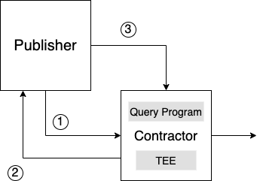
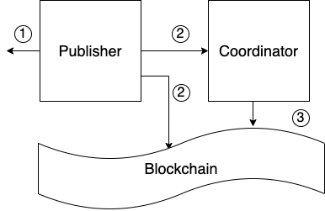
Security Risks & Challenges
Query Result Integrity
In AnyLog we have publishers and coordinators that do not trust query results from some contractors. Though nodes can still interact by verifying query results via TEE and ADS.
Integrity through TEE (Trusted Execution Environment)
Ship signed data to contractor
Publisher verifies the authenticity of the TEE and Query Program
Publisher issues a certificate for the contractor. Contractor can show the certificate to coordinators.
Integrity through ADS (Authorized Data Structure)
Publisher produce data in batches
Publisher generate a digest and a version number for the produced data. Then it post this information on the blockchain or it does distribute it to all coordinators
The coordinator can retrieve data digest and version number from the blockchain. (then it checks integrity from contractor).
https://www.cs.ucy.ac.cy/~dzeina/courses/epl646

Slide 22
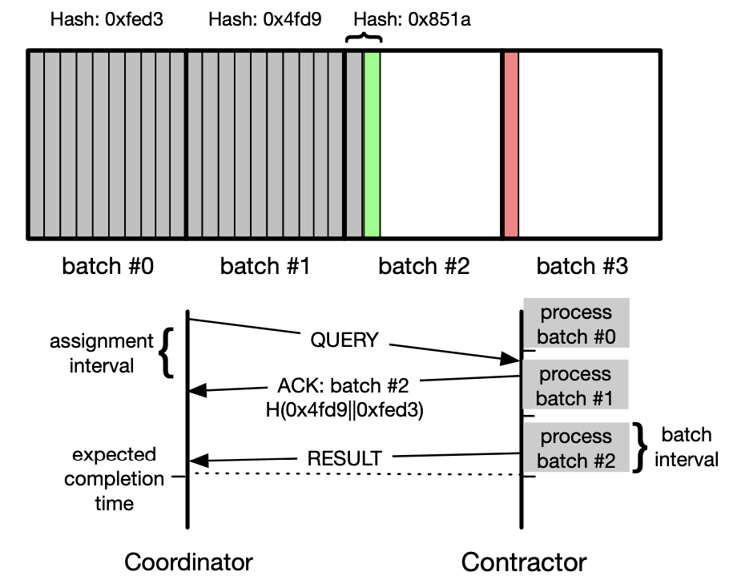
Security Risks & Challenges
SLA enforcement
As we discussed earlier when a dispute occur a penalty may be the solution. AnyLog provides a mechanism to detect disputes and fairly penalize the network parties.
Each Contractor must serve certain number or records during a specified duration.
A Contractor process queries in batches. Batches have an execution interval. (usually interval is counted in blockchain blocks).
For example, when a new query comes, it is placed in the batch where there is available space. Then, a response containing the previous (full) batches hash is returned to the Coordinator.
Consequently the Coordinator will be able to know by checking the blockchain if the query result is returned on time.
If it is not returned on time, we have an SLA violation which can be detected through blockchain.
https://www.cs.ucy.ac.cy/~dzeina/courses/epl646

Slide 23
Security Risks & Challenges
Data Confidentiality … is that a challenge?
In AnyLog publishers will either publish public data or will encrypt their data. Usually all publishers post public data. When data are encrypted we have some limitations when we need to query them.
Problems / Issues
We can not query encrypted data on Contractors easilly
Unfortunately CryptDB has some drawbacks.
CryptDB uses a proxy to message encryption and decryption keys. Not all entities will trust the proxy.
Publishers may not want certain client to query their data
Client may try to resell data to third parties, which is illegal.
The case of Malicious publishers (eg spam or fake data)
Solutions
Use mechanisms such as CryptDB that provide confidentiality, while it allows us to do encrypted query processing
Use “FreeLoading” which solves our problem somehow
There is no silver bullet solution to this problem. To partially give a solution we use reputation methods. Coordinators will act like a search engine contact reputable Contractors
https://www.cs.ucy.ac.cy/~dzeina/courses/epl646

Slide 24
06
Use Cases & Conclusion

Slide 25
Use Cases & Conclusion
Use Cases
Cloud Alternative
Data Storage at the edge
Funded Hardware
https://www.cs.ucy.ac.cy/~dzeina/courses/epl646

Slide 26


Use Cases & Conclusion
Conclusion
AnyLog process an architecture that devides responsibilities across different node types :
Publishing
Storage
Processinng
AnyLog provides security mechanisms :
Secure query processing
Blockchain
Trusted Execution Environment
Challenges
Scalability
Efficiency
Wider range of query processing operations
Federating query processing over many independent contractors
Calculate accurate query costs
https://www.cs.ucy.ac.cy/~dzeina/courses/epl646

